Slide 1
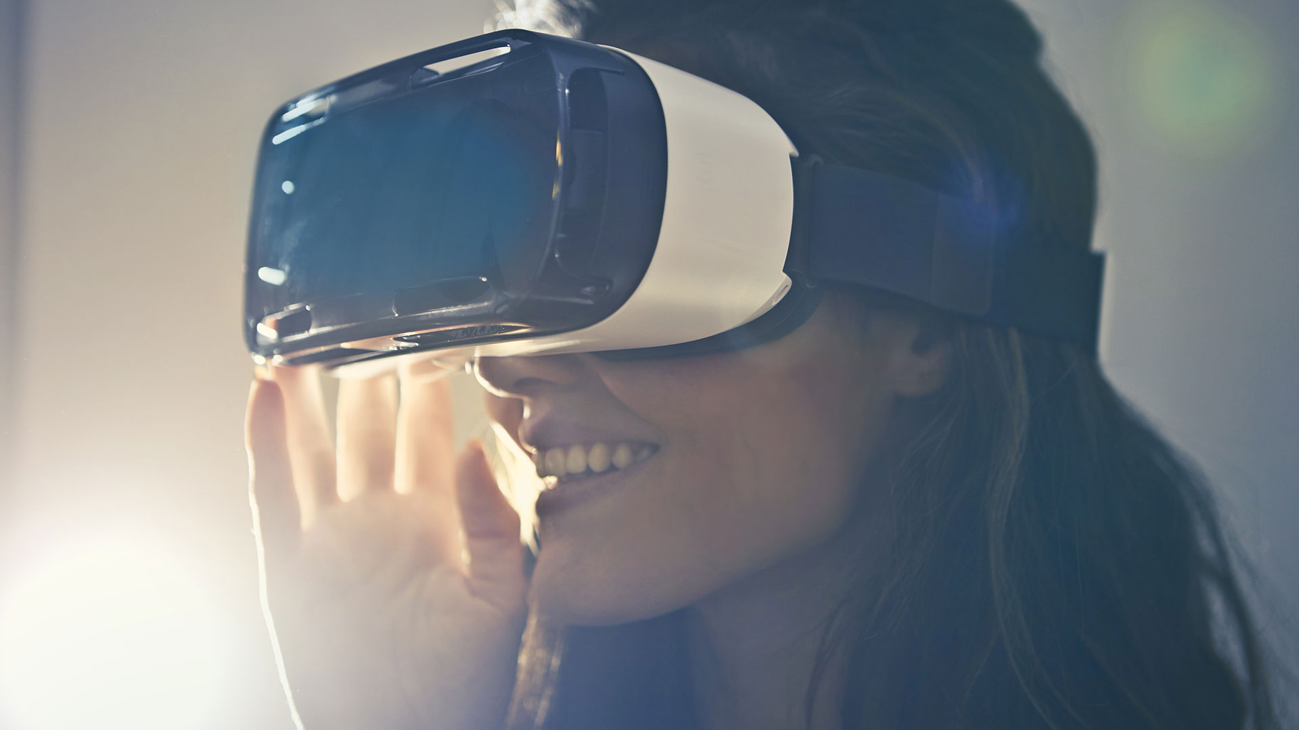


SITTING IS THE NEW SMOKING!
Dr. Tyler Crooks Integrated Health Solutions
And other gross exaggerations

Slide 2

Problem:
Stock Photo Brad’s neck is stuck like this. He smiles through the pain.
WHAT: 86% of people that work in a seated position eventually develop neuromusculoskeletal complaints significant enough to seek medical attention
Headaches, TMJ Dysfunction, Neck Pain, Thoracic Outlet Syndrome, Low Back Pain, Osteoarthritis, Degenerative Disc Disease, Carpal Tunnel Syndrome, etc.
WHY: Your function is largely dictated by the positions you routinely subject yourself to
Muscles shorten/tighten
Joint ROM decreases
Stabilizing muscles stop doing their job
Motor patterns deteriorate
HOW TO FIX IT: MOVE
*please make it stop
Your job requires you to sit at a computer most of the day. Your body doesn’t enjoy it.

Slide 3

Upper Crossed Syndrome
OVERWORKED, UNDERPAID
Suboccipitals
Upper Trapezius
Levator Scapulae
Pectoralis Major/Minor
ASLEEP AT THE WHEEL
Deep Cervical Flexors
Lower Trapezius
Understanding the long-term effect

Slide 4
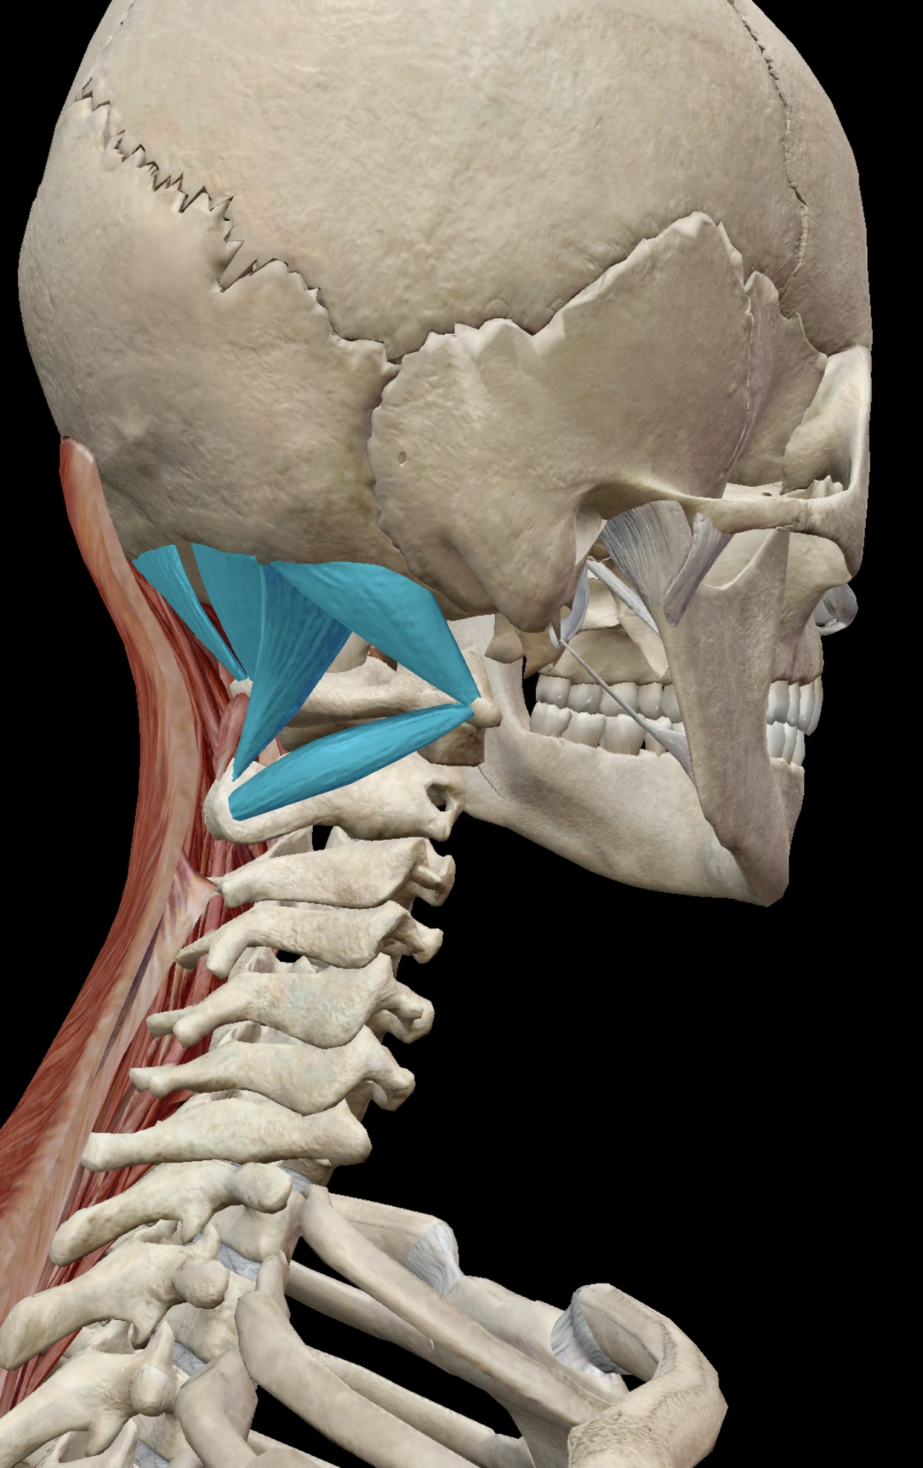
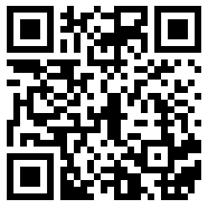
Suboccipital Muscles
The “Too Tight” Crew:
The common denominator amongst headaches, neck pain and screen time
Your new rescue inhaler for headaches

Slide 5
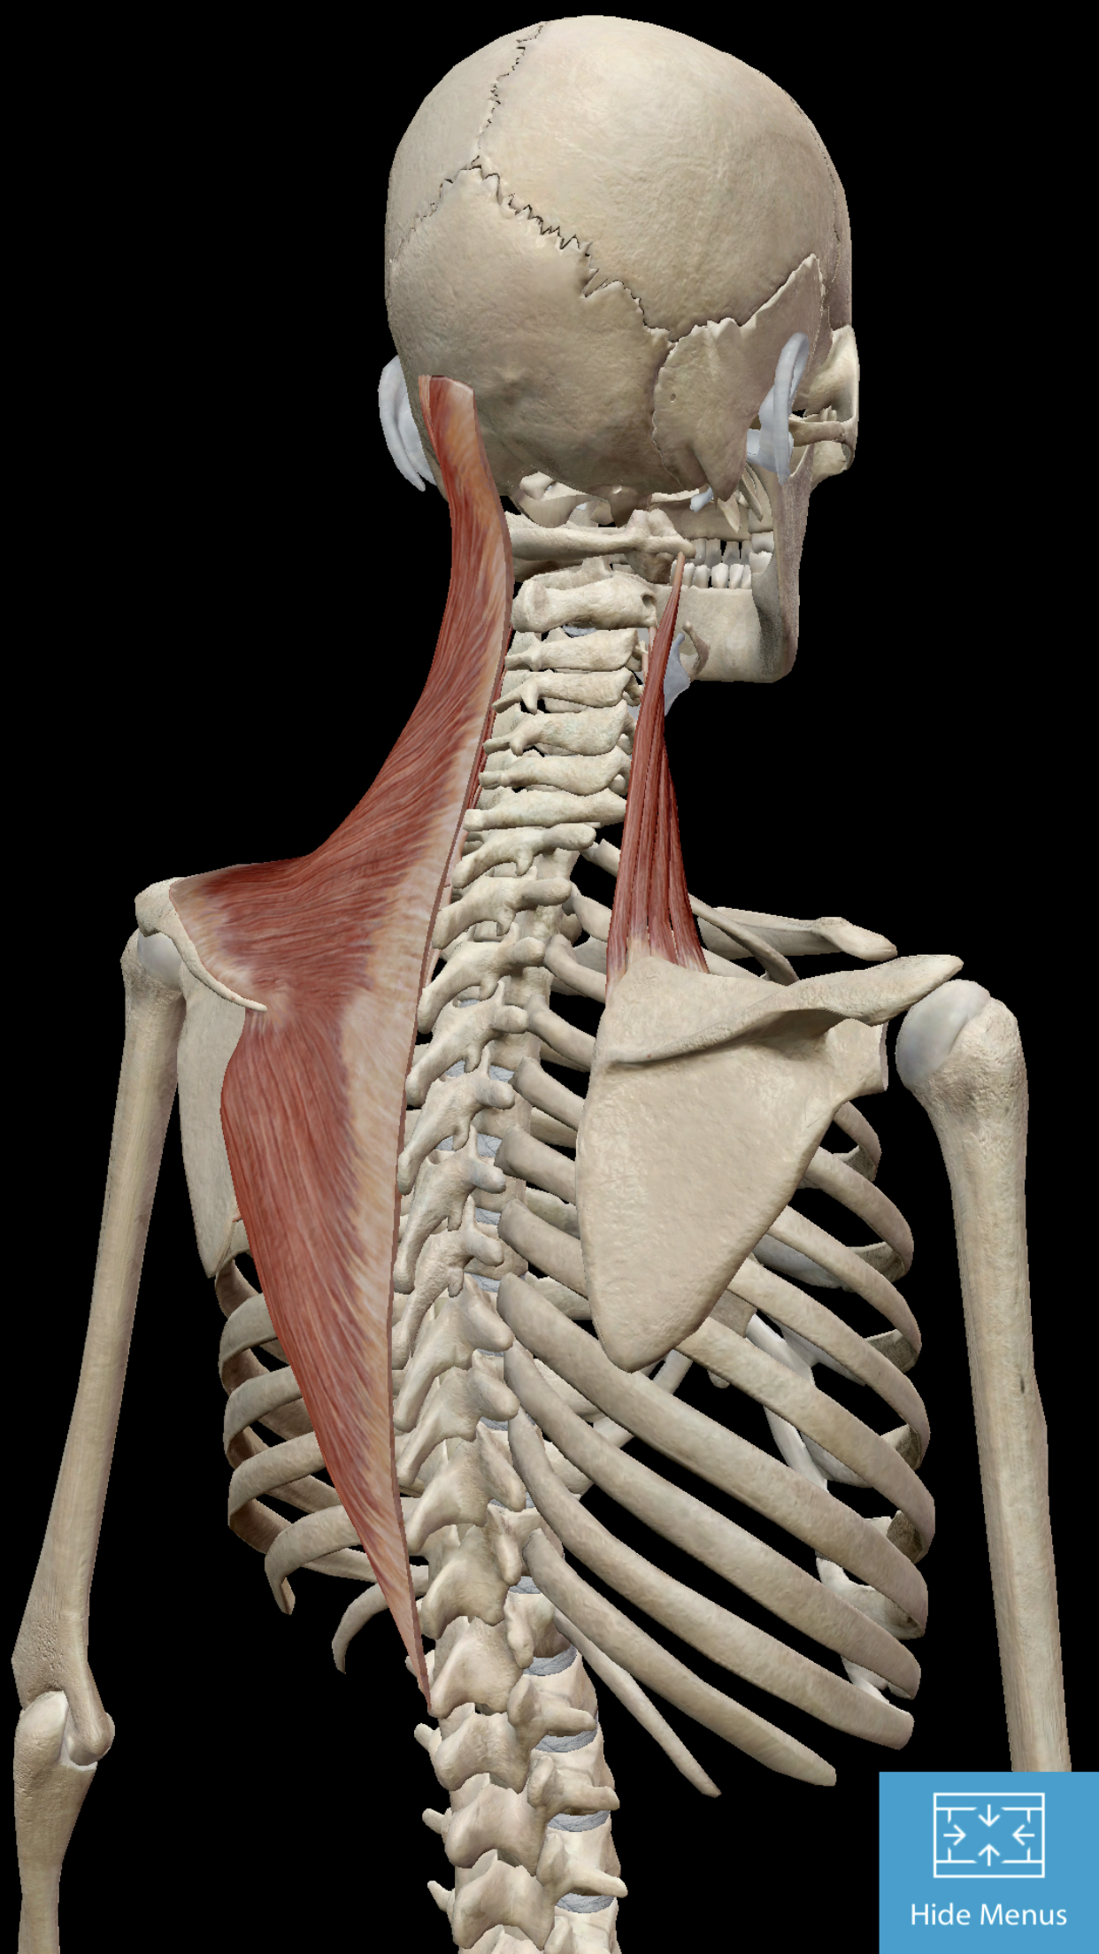
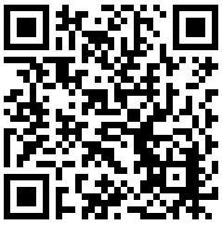
Upper Trapezius & Levator Scapulae
The “Too Tight” Crew:
“I carry all the stress and tension in my neck”
Tight? Tender? Smash it.

Slide 6
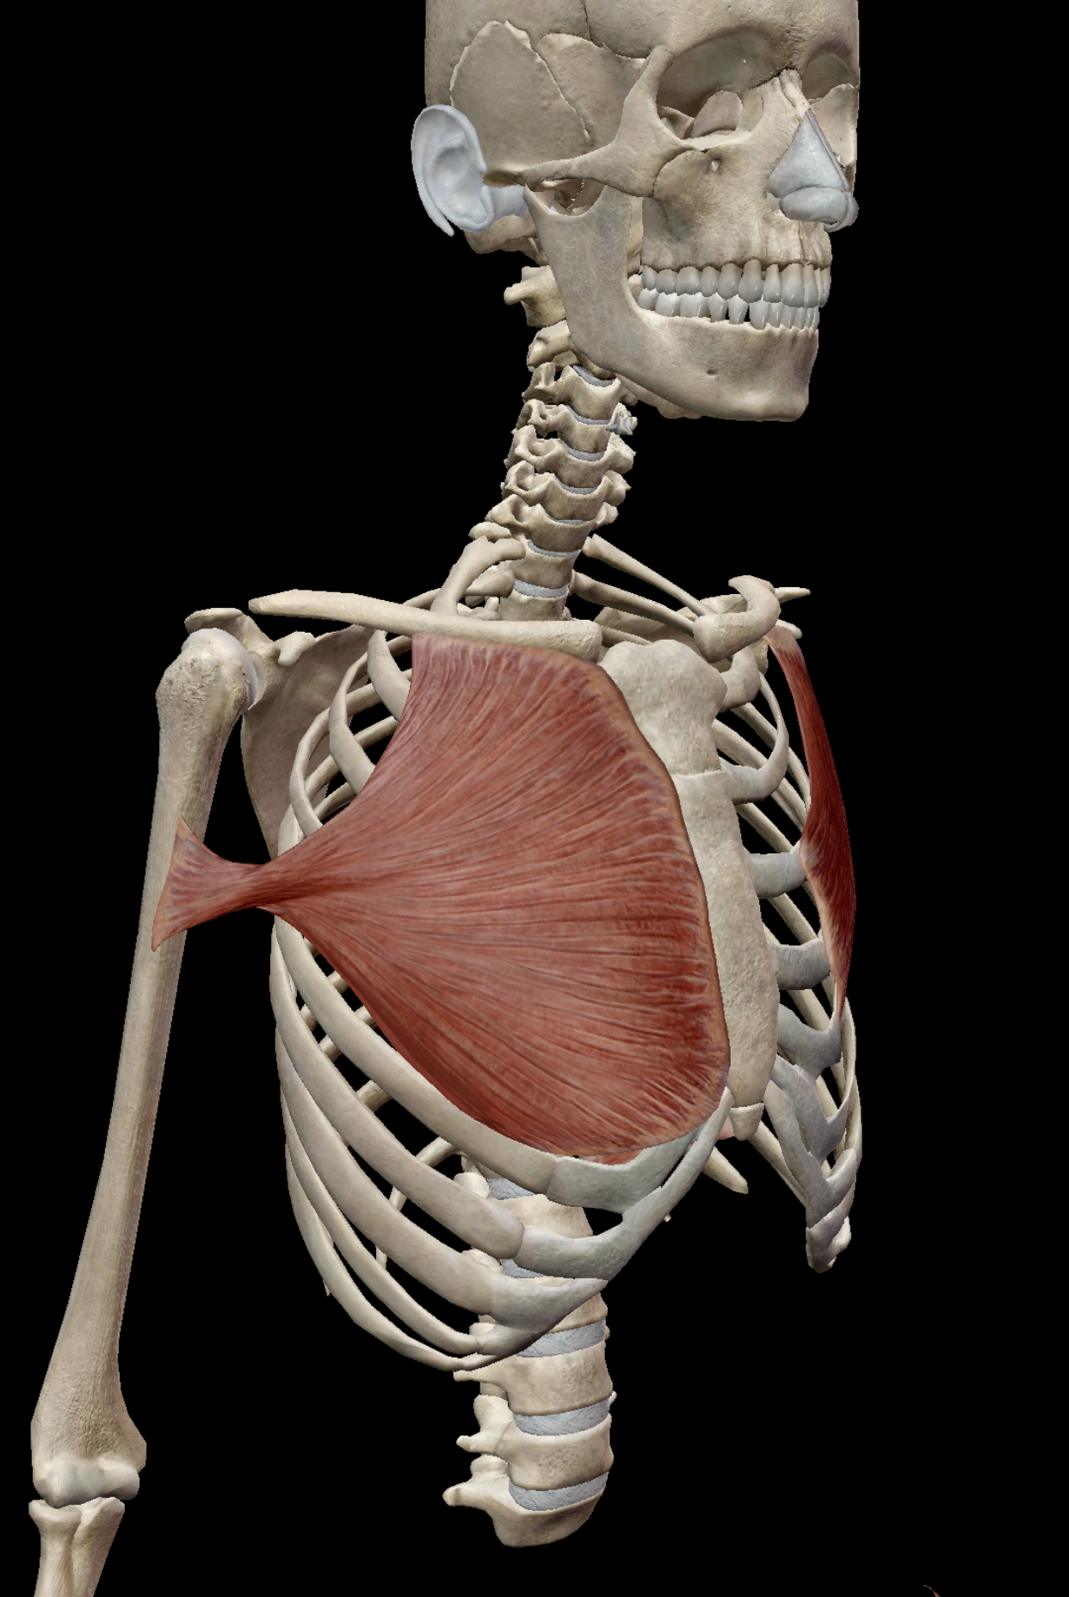
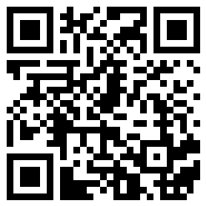
Pectoralis Major & Minor
The “Too Tight” Crew:
Often tight, definitely not helping your benchpress
You can do THIS to fix it

Slide 7
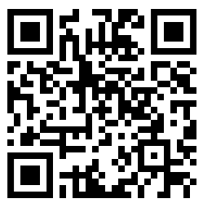
The Lower Trapezius
Asleep at the Wheel:
The red-headed stepchild of the neck and shoulder girdle complex
DO SOMETHING ABOUT IT!

Slide 8


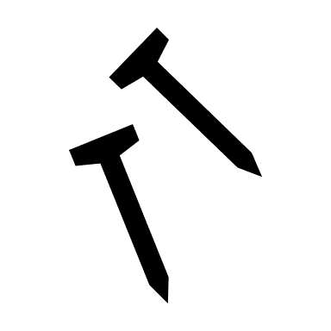
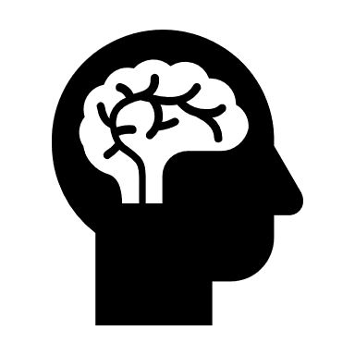

Need a Refresher Course?
Cryotherapy
Dry Needling
Cold makes you better
Arch nemesis of trigger points
Sensory Deprivation
Chiropractic/PT
Nobody expects you to remember all of this. I barely remember what I had for breakfast.
Get to know your own mind so you don’t lose it
Evidence-based, outcome oriented

Slide 9
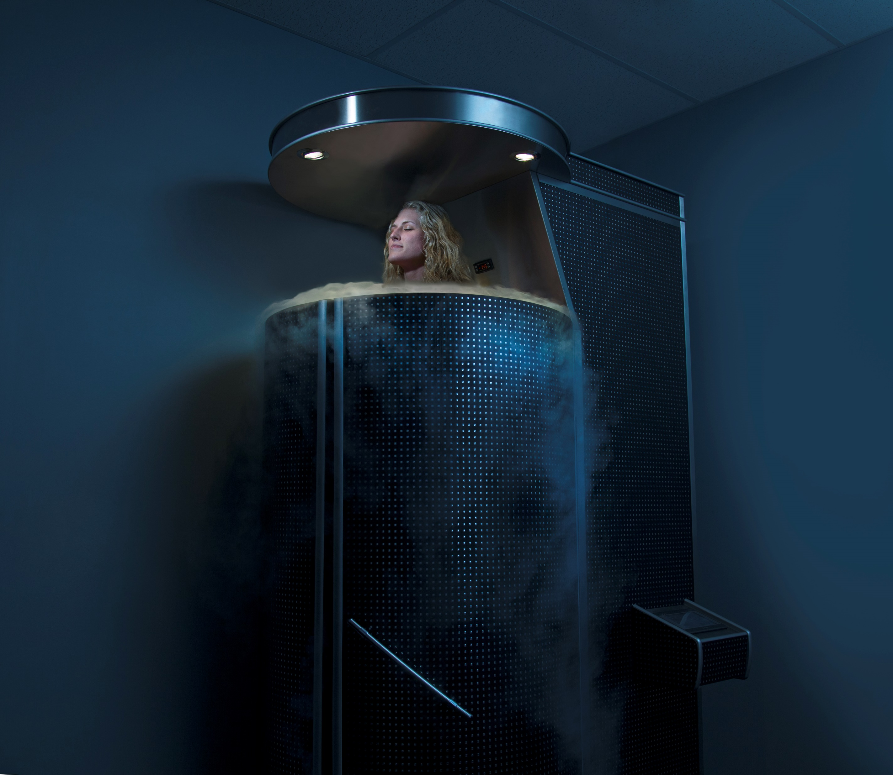
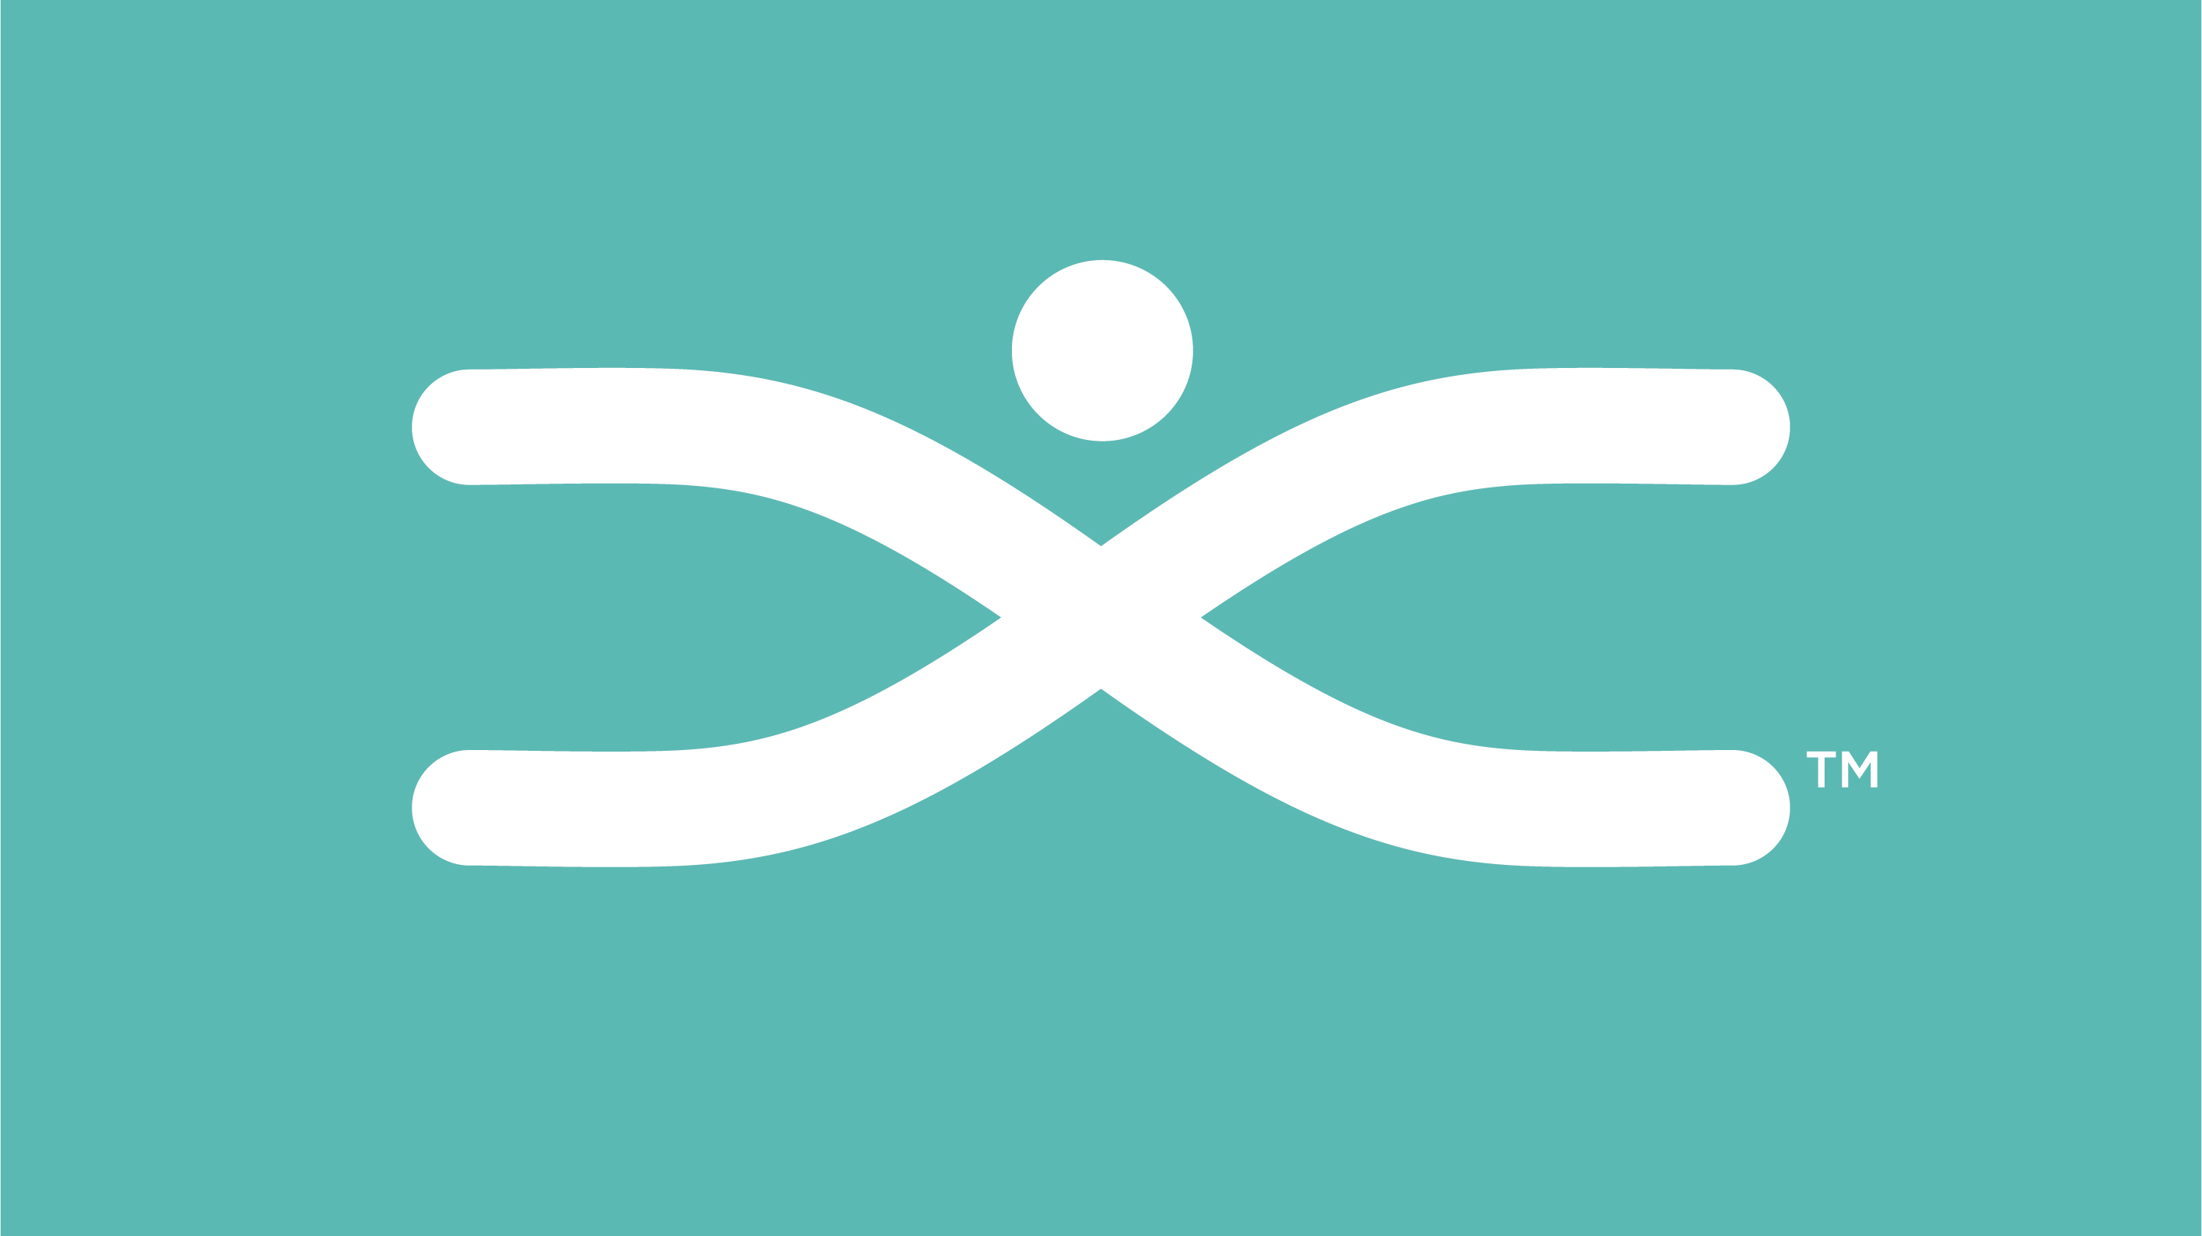
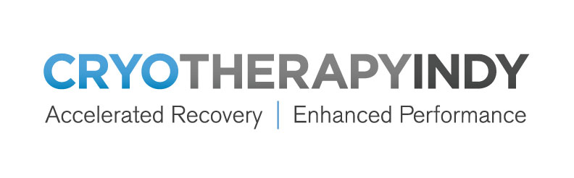
Want to learn more?
CRYOTHERAPYINDY.COM
IHSINDY.COM

